Slide 1
The First 20 Elements
Reading The Periodic Table

Slide 2
Chemistry Basics
All of the matter in the universe (what we call “stuff”) is made of just about 100 different kinds of atoms.
Everything in your world is made up of simple combinations of these basic building blocks called atoms.
Chemistry is the study of how these atoms combine and the products they create.

Slide 3
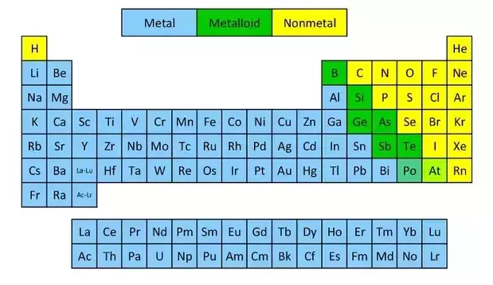
The Periodic Table
Contains almost all of the information about all of the elements on one page.

Slide 4
Reading The Periodic Table
Each box on the periodic table represents a different element
It contains vital information about the element
Atomic Number
6 C Carbon 12.011
Element Symbol
Element Name
Atomic Mass

Slide 5
Reading The Periodic Table
Each box on the periodic table represents a different element
It contains vital information about the element
Atomic Number
6 C Carbon 12.011
Element Symbol
Element Name
Atomic Mass
Note: Always round the Atomic Number to a whole number. e.g. C = 12

Slide 6
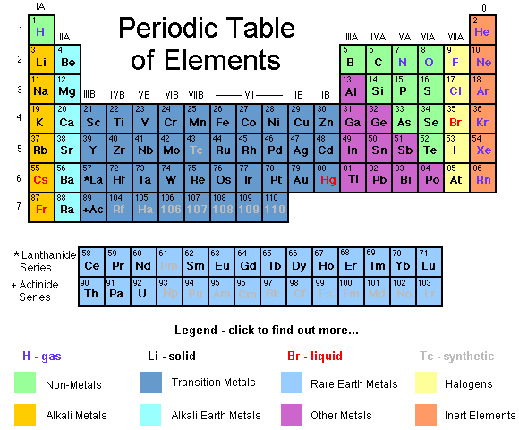

Slide 7
Practice:
Warm-up Questions:
Element name for the symbol “P”
Symbol for the element “Potassium”
Atomic number for the symbol “Ag”
Atomic mass for “Gold”
First 20 Elements Worksheet
Only complete Part #1 information:
Number, Symbol, Name, Atomic Mass & Metal / Non-Metal
Do questions for Part #1

Slide 8
First 20 Elements Questions
Part #1
What do you notice about how the Periodic Table is organized by the Atomic Number of the elements?
What do you notice about the ordering of the Atomic Mass of the elements? (e.g. Are they all in order?)

Slide 9
First 20 Elements Questions
Part #2
What do you notice about the number of protons and the number of electrons for each element?

Slide 10
First 20 Elements Questions
Part #3
Are the number of neutrons related to the number of protons or electrons?

Slide 11
First 20 Elements Questions
Part #5
What pattern do you see in the Lewis Dot diagrams showing the outer valence electrons for each element in the same group (column)?
What pattern do you see in the Lewis Dot diagrams for each element in the same period (row)?

Slide 12
First 20 Elements Questions
Part #1
What do you notice about how the Periodic Table is organized by the Atomic Number of the elements?
What do you notice about the Atomic Mass of the elements?
Part #3
What do you notice about the number of protons and the number of electrons for each element?
Are the number of neutrons related to the number of protons or electrons?
Part #6
What pattern do you see in the Lewis Dot diagrams showing the outer valence electrons for each element in the same column?
What pattern do you see in the Lewis Dot diagrams for each element in the same row?

